Slide 1

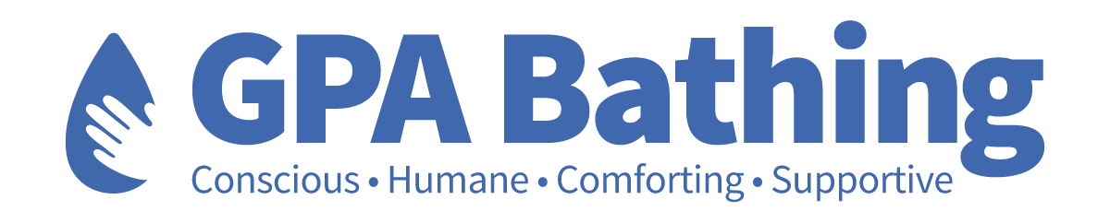


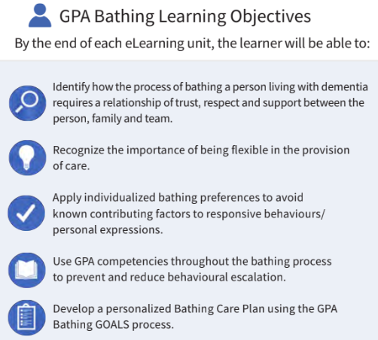
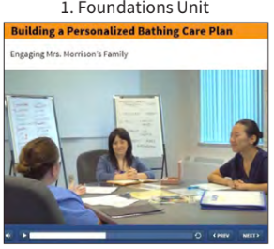
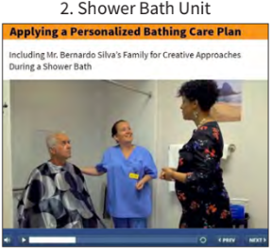
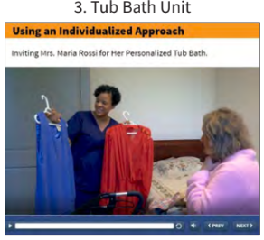
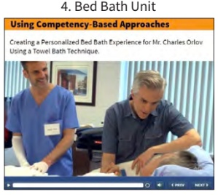
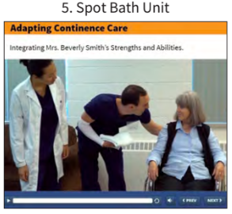
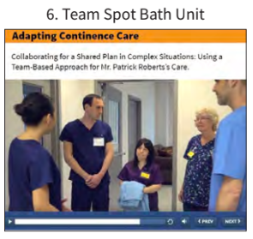
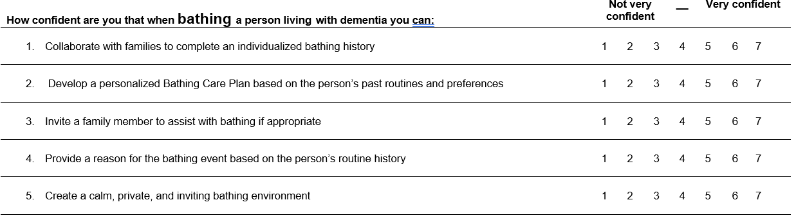
GPA Bathing: A six-unit eLearning curriculum to increase confidence and knowledge of final-year nursing students when bathing persons living with dementia
Angel Wang, Lori Schindel Martin, Michele Bliss, Victoria McLelland
Advanced Gerontological Education, Hamilton, Canada
Daphne Cockwell School of Nursing, Toronto Metropolitan University, Toronto, Canada
Background
GPA BATHING
Bathing can cause significant distress for persons living with dementia.
Of all personal care activities, assisted bathing is a daily care activity that leads to the most responsive behaviours and reported as one of the most difficult activities to perform.
Yet limited formal education is available for nursing students to learn dementia-specific bathing interventions.
Nursing students often experience anxiety and uncertainty, and are unprepared on how to provide person-centered care to persons with bathing-related responsive behaviours in clinical practice.
Advanced Gerontological Education developed a Gentle Persuasive Approaches (GPA) Bathing eLearning curriculum to strengthen care providers’ knowledge, confidence, and skill to provide person-centered, evidence-informed bathing care. The curriculum, comprised of 6 units, was developed upon best practice bathing competencies identified in the literature and included video case studies.
METHODS
Purpose: To evaluate the impact of completing a standardized online dementia education program on undergraduate nursing students’ self-efficacy and knowledge in providing person-centered care to persons with bathing-related responsive behaviours
Design: Mixed-methods, within-subjects, repeated measures
Sample: 4th year nursing students at Toronto Metropolitan University
Intervention: Participants completed the GPA Bathing curriculum between 2022-2023 academic year (3 units in Fall 2022 and 3 units in Winter 2023)
Data Collection from Sept 2022 to May 2023:
1) Self-Perceived Behavioural Management Self-Efficacy Profile for Bathing (SBMPSEP-B)
Completed both pre- and post-GPA Bathing
20-item, 7-point Likert-type scales and open-ended questions about best practices (Cronbach’s alpha = 0.96)
RESULTS
Qualitative Findings: Pre-GPA Bathing
Quantitative Results: Bathing Knowledge
Bathing older people experiencing responsive behaviours makes me feel:
Scared, anxious, and concerned about safety
Incompetent, lack of confidence, and helpless
Uncomfortable, stressed, and frustrated
Midway through the GPA Bathing units (post units 1-3), participants showed a significant increase in their Bathing Knowledge Test scores relative to baseline (p<.001).
“It makes me feel sad & helpless that I couldn't help the individual meet their needs.”
“Unconfident, scared, bad nurse.”
Strategies used when bathing older people with responsive behaviours are:
Re-approach; leave and return
Remain calm, take it slow, and get support
Incorporate explanations, choices, and preferences
Distractions and redirection; Basic communication techniques
What students hoped to learn from GPA Bathing:
2) Bathing Knowledge Test
Completed at 3 time points: pre, mid, and post-GPA Bathing
12 questions, multiple choice questions
3) Satisfaction Questionnaire
10-item, 7-point Likert-type scale completed post-GPA Bathing
Data Analysis:
Paired t-test, one-way repeated measures ANOVA for quantitative data
Content analysis for qualitative data
“To be more confident and have tools to address difficult issues.”
“Correcting what I learned in the field that was perhaps not ‘best practice’.”
CONCLUSION
Without adequate education, nursing students will continue to perpetuate the stigma associated with gerontological nursing, such as viewing caring for older adults as “heavy”, “dirty work” and “low-status”
Caring for older adults are not preferred or viewed negatively among nursing students due to the inference that highly scientific skills and care approaches are not required
According to existing literature, gerontological nursing is often the least preferred area of practice among nursing students
GPA Bathing will not only help nursing students cultivate more confidence and knowledge in bathing care, but also will facilitate the development of newfound understandings of the complexity of dementia care
The eLearning component of the GPA Bathing curriculum aligns with the current trends as education has increasingly transitioned to virtual platforms to increase accessibility
*We are still collecting post-GPA Bathing data so we are only reporting pre- and mid-GPA Bathing data*

